Slide 1
Malignant Commentes Classifier
By
Debanti Roy

Slide 2
Malignant Commentes Classifier
The proliferation of social media enables people to express their opinions widely online. However, at the same time, this has resulted in the emergence of conflict and hate, making online environments uninviting for users. Although researchers have found that hate is a problem across multiple platforms, there is a lack of models for online hate detection.
Online hate, described as abusive language, aggression, cyberbullying, hatefulness and many others has been identified as a major threat on online social media platforms. Social media platforms are the most prominent grounds for such toxic behavior.

Slide 3
Malignant Commentes Classifier
There has been a remarkable increase in the cases of cyberbullying and trolls on various social media platforms. Many celebrities and influences are facing backlashes from people and have to come across hateful and offensive comments. This can take a toll on anyone and affect them mentally leading to depression, mental illness, self-hatred and suicidal thoughts.
Internet comments are bastions of hatred and vitriol. While online anonymity has provided a new outlet for aggression and hate speech, machine learning can be used to fight it. The problem we sought to solve was the tagging of internet comments that are aggressive towards other users. This means that insults to third parties such as celebrities will be tagged as unoffensive, but “u are an idiot” is clearly offensive.

Slide 4
Problem Statement
Our goal is to build a prototype of online hate and abuse comment classifier which can used to classify hate and offensive comments so that it can be controlled and restricted from spreading hatred and cyberbullying.

Slide 5
Multi –Label Classification Problem
Difference between multi-class classification & multi-label classification is that in multi-class problems the classes are mutually exclusive, whereas for multi-label problems each label represents a different classification task, but the tasks are somehow related.
For example, multi-class classification makes the assumption that each sample is assigned to one and only one label: a fruit can be either an apple or a pear but not both at the same time. Whereas, an instance of multi-label classification can be that a text might be about any of religion, politics, finance or education at the same time or none of these.
Multi-label classification of textual data is an important problem. Examples range from news articles to emails.
For instance, this can be employed to find the genres that a movie belongs to, based on the summary of its plot.

Slide 6
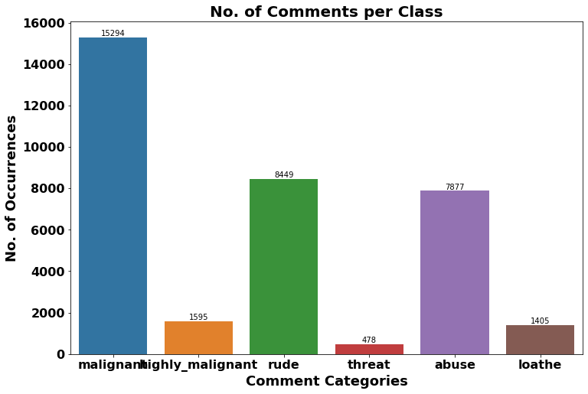
Exploration of Target Variable Ratings
Looks like majority of negative comments are Malignant in nature followed by rude categories whereas there is minimum comments that are threatening in nature.

Slide 7
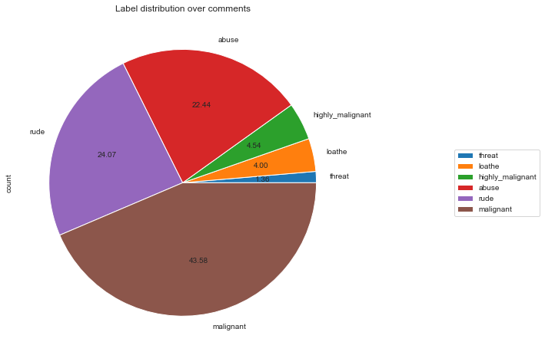
The plot shows that around 90% comments are Good/Neutral while the rest 10% comments are Negative in nature. Additionally, out of total negative comments 43.58% are malignant followed by 24.07% are rude comments.

Slide 8
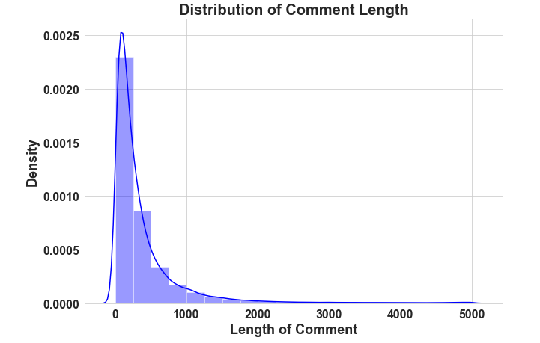
In the plot we can see most of the comments are short with only a few comments longer than 1000 words. Furthermore, majority of the comments are of length 500, where maximum length is 5000 and minimum length is 5. The Median length being 250.

Slide 9
Data Pre Processing
Dropped unwanted entries in the columns.
Described the statistical details of the features using “.describe()” method.
Checked null values we have used “.isnull().sum().any()”.
Used “Pearson’s method” to check the correlation between the features.
Performed both univariate and bivariate analysis using seaborn and matplotlib.
Removed Punctuations and other special characters
Used Word Tokenzation
Removed Stop Words
Applied Stemming and Lemmatising
Applied Count Vectorizer

Slide 10
Word Cloud

Slide 11
Word Cloud for getting word sense
Word Cloud is a visualization technique for text data wherein each word is picturized with its importance in the context or its frequency.
The more commonly the term appears within the text being analysed, the larger the word appears in the image generated.
The enlarged texts are the greatest number of words used there and small texts are the smaller number of words used.

Slide 12
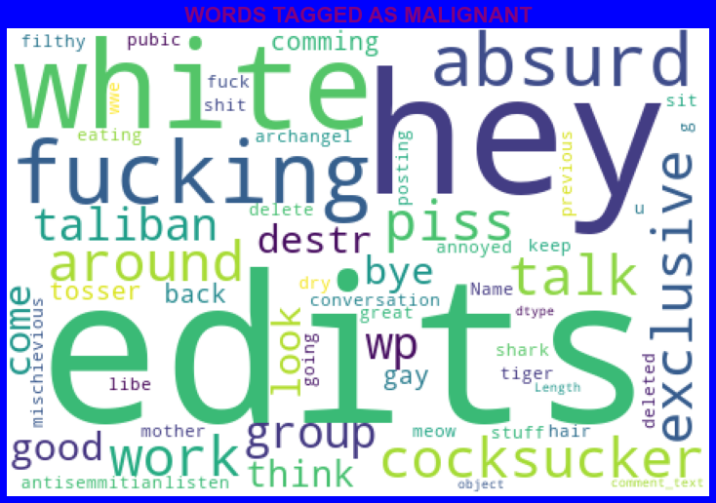
The shows WordCloud shows WORDS TAGGED AS HIGHLY MALIGNANT
It is clear that there are mostly words like edits, hey, white, fucking, gay, cocksucker, work, think, taliban, etc.

Slide 13
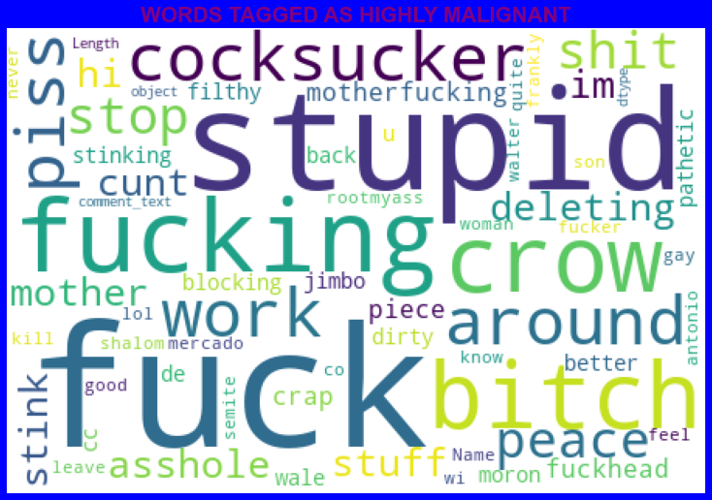
The WordCloud shows WORDS TAGGED AS HIGHLY MALIGNANT
It is clear that there are mostly words like stupid, fuck, fucking, bitch, crow, shit, etc.

Slide 14
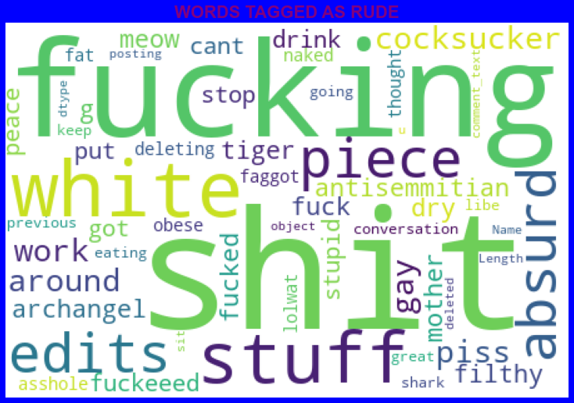
The WordCloud shows WORDS TAGGED AS RUDE
It is clear that there are mostly words like fucking, shit, white, piece, edits, stuff, absurd, etc.

Slide 15
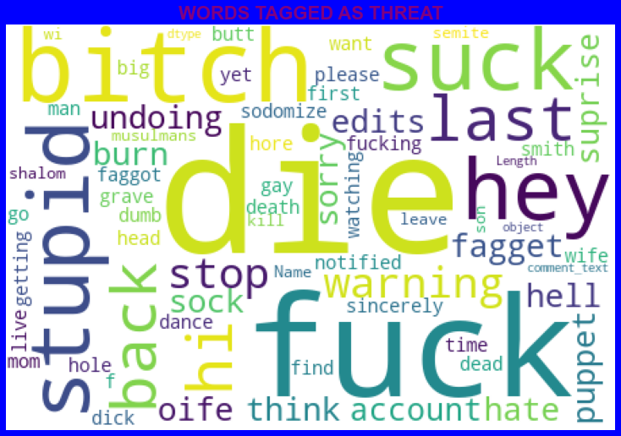
The WordCloud shows WORDS TAGGED AS THREAT
It is clear that there are mostly words like fuck, suck, Bitch, die, stupid, etc.

Slide 16
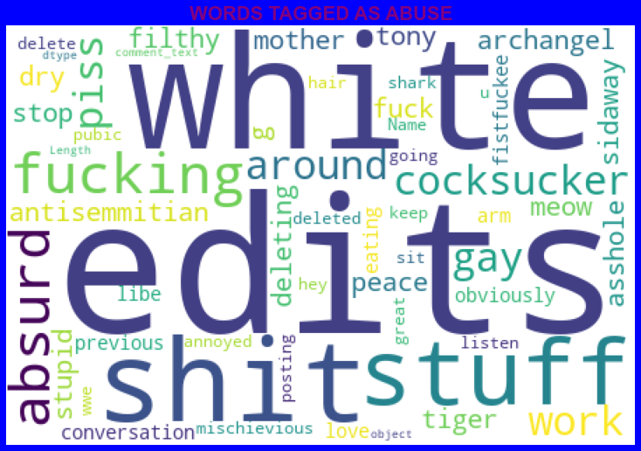
The WordCloud shows WORDS TAGGED AS ABUSE
It is clear that there are mostly words like edits, white, shit, stuff, fuck, piss, fucking etc.

Slide 17
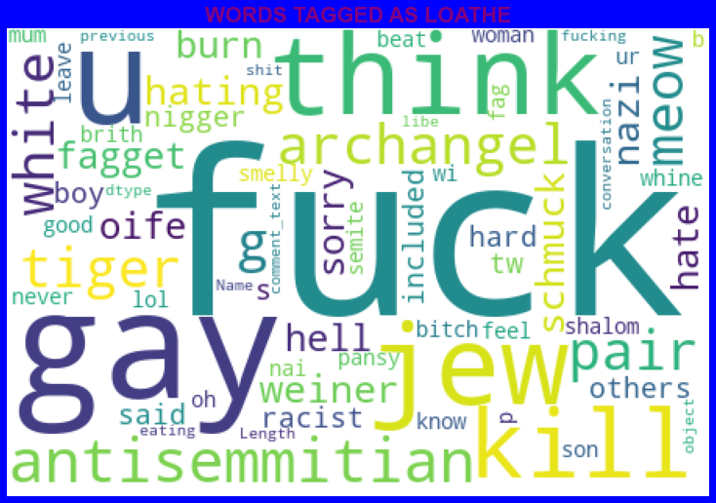
The WordCloud shows WORDS TAGGED AS LOATHE
It is clear that there are mostly consists of words like fuck, u, kill, gay, think, jew, etc.

Slide 18
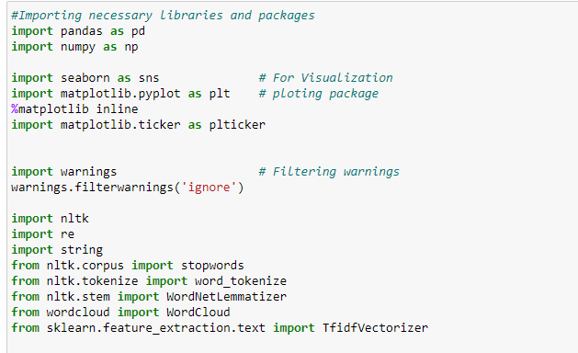
Visualization & Data Wrangling Library used

Slide 19
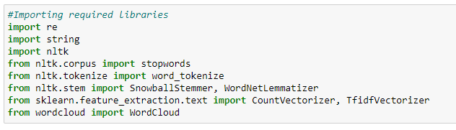
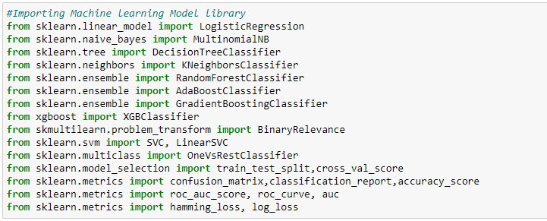
Text Mining Library used
Machine Learning Model Building Library used

Slide 20
Machine Learning Model Building

Slide 21
Machine Learning Model Building
The different classification algorithm used in this project to build ML model are as below:
Random Forest classifier
Support Vector Classifier
Logistics Regression
AdaBoost Classifier

Slide 22

Machine Learning Evaluation Matrix
Support Vector Classifier gives maximum Accuracy Score: 91.1508 % and Hamming Loss: 2.0953% than the other classification models.
Hyper parameter Tuning is perform over this best model using best param shown below :

Slide 23
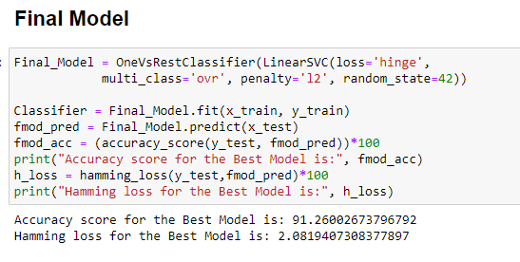
Final ML Model
We have selected Linear Support Vector Classifier as our final model as it gave an accuracy of 91.15%. After hyperparameter tuning we could see the accuracy enhanced to 91.26%.

Slide 24
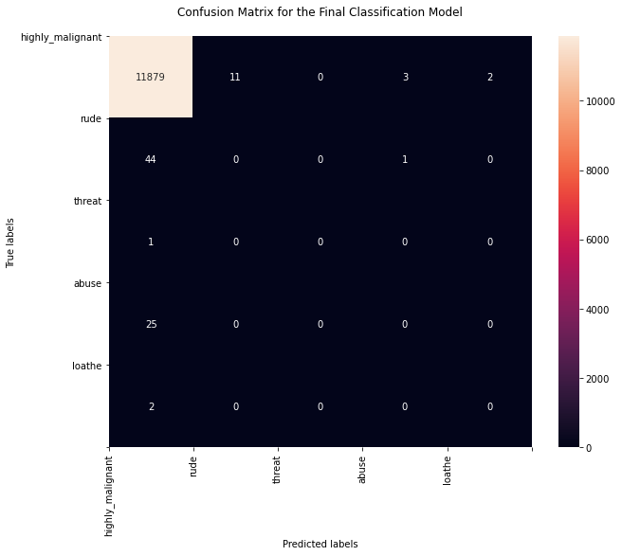
Confusion Matrix

Slide 25
Machine Learning Evaluation Matrix
Algorithm | Accuracy Score | Recall (Micro) | Precision (Micro) | F1 Score (Micro) | Humming Loss
Logistics Regression | 0.9123 | 0.89 | 0.94 | 0.61 | 0.02206
Random Forest Classifier (RFC) | 0.9074 | 0.56 | 0.79 | 0.66 | 0.02191
Support Vector Classifier | 0.9115 | 0.56 | 0.82 | 0.67 | 0.02952
Ada Boost Classifier | 0.9057 | 0.50 | 0.80 | 0.61 | 0.9057
Algorithm | Accuracy Score | Recall (Micro) | Precision (Micro) | F1 Score (Micro) | Humming Loss
Logistics Regression | 0.9123 | 0.89 | 0.94 | 0.61 | 0.02206
Random Forest Classifier (RFC) | 0.9074 | 0.56 | 0.79 | 0.66 | 0.02191
Support Vector Classifier | 0.9115 | 0.56 | 0.82 | 0.67 | 0.02952
Ada Boost Classifier | 0.9057 | 0.50 | 0.80 | 0.61 | 0.9057

Slide 26
CONCLUSION
Linear Support Vector Classifier performs better with Accuracy Score: 91.15077857956704 % and Hamming Loss: 2.0952019242942144 % than the other classification models.
Final Model (Hyperparameter Tuning) is giving us Accuracy score of 91.26% which is slightly improved compare to earlier Accuracy score of 91.15%.
SVM classifier is fastest algorithm compare to others.

Slide 27
Limitations of this work and Scope for Future Work
The data is imbalanced but we couldn’t apply balancing techniques due to computational limitations.
We have used 2000 as the maximum feature for vectorising. Thus, for more features the models can produce ineffective results.
Deep learning CNN, ANN can be used to build more accurate models.

Slide 28


